Slide 1


Navigating the Curriculum Design & Proposal Process
Presented by: Ms. Rebecca A. Nelson Curriculum Coordinator/Specialist
Working Connections, Summer Conference
June 23, 2022

Slide 2

Presentation Highlights
The goal of this presentation is to serve as a helpful guide to successfully navigate the curriculum process from development to implementation.
Better understanding of the critical steps required to submit a curriculum proposal
Ease of accessibility to institutional and Florida Department of Education resources to support curriculum initiatives
Increased awareness of the SACSCOC and specialized curricular accountability requirements.
Enhanced comprehension of curriculum data input to the various College repositories and the Statewide Course Numbering System

Slide 3


Dedication to the Curriculum Process
Well organized and carefully planned curriculum directly supports a key strategic goal:
Increase the Success of Students

Slide 4

The Curriculum Lifecycle
Ongoing, iterative process
Annual course purge (courses not taught in five years)
Assessment updates
Course outline reviews
Program reviews
Resource demands
Sources of Change
Faculty-Initiated
Discipline best practice
State-Mandated
New, modified, inactivated
Business and Industry Leadership Team-Supported
Community or employer need

Slide 5

Types of Curriculum
A curriculum proposal may include a variety of different actions:
New course or program
Modified course or program
Inactivated course or program
Reactivated course or program

Slide 6

Critical Collaboration
According to OxfordDictionaries.com, Collaboration is defined as: “The action of working with someone to produce something.”
Types of Collaborators
Business and Industry Leadership Team (BILT)
Community partnerships
Educational meetings
Faculty discipline councils
Schools of:
Business, Professional Studies and Public Safety
Health, Education and Human Services
Technology and Industry
Liberal Arts and Sciences

Slide 7
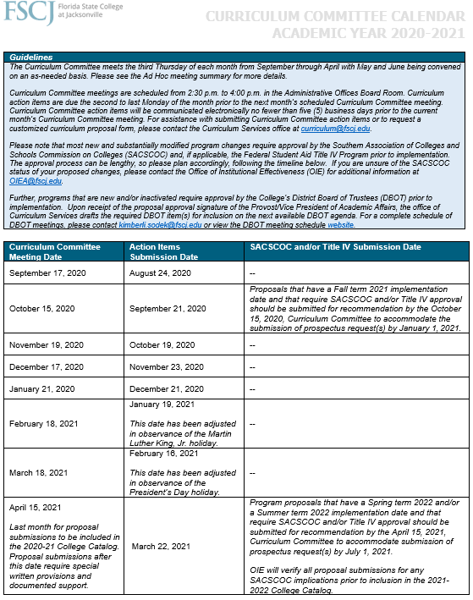

Planning Ahead
Curriculum Committee calendar of proposal submission deadlines and meeting dates
Curriculum Committee meetings
Proposal submission timeline
SACSCOC and Financial Aid deadlines
College Catalog production schedule

Slide 8


Steps to Initiate Curriculum
#1 Goal
=
Student Success
Discuss with fellow discipline and/or program faculty members
Ensure support from appropriate discipline council(s) and/or Business and Industry Leadership Team (BILT’s) members
Communicate with the appropriate instructional program manager(s) or department chair(s), dean(s) and Associate Provost
Contact the office of Curriculum Services to request a prefilled proposal template form customized for the type of change requested
Verify the Curriculum Committee calendar proposal submission deadlines and meeting dates
Consider any District Board of Trustees, SACSCOC and/or Financial Aid impact

Slide 9
Steps to Initiate Curriculum Continued…
#1 Goal
=
Students
Gather administrative support signatures from the appropriate instructional program manager(s) or departments chairs and dean(s)
Email the completed proposal template in *.docx format to curriculum@fscj.edu along with a PDF of the signature page and request a complete technical review
Receive support signature from the appropriate Associate Provost
Give a short presentation to the Curriculum Committee and receive recommendation signature from the Chair
Obtain approval signature from the Provost/Vice President of Academic Affairs
Return to the office of Curriculum Services for systems input and report processing

Slide 10
Curriculum Proposal Design

Slide 11


Curriculum Proposal Form
Did you know that the office of Curriculum Services will prepare a prefilled, custom proposal template for your use?
Did you know that the office of Curriculum Services will partner with its originator(s) to write the proposal narrative so that faculty may remain dedicated to focus on curricular content review, course topic analysis and current learning outcomes and assessment methods?

Slide 12
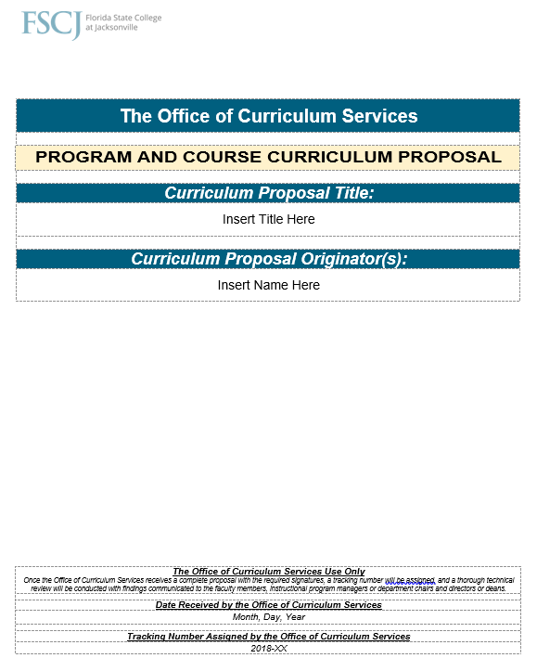
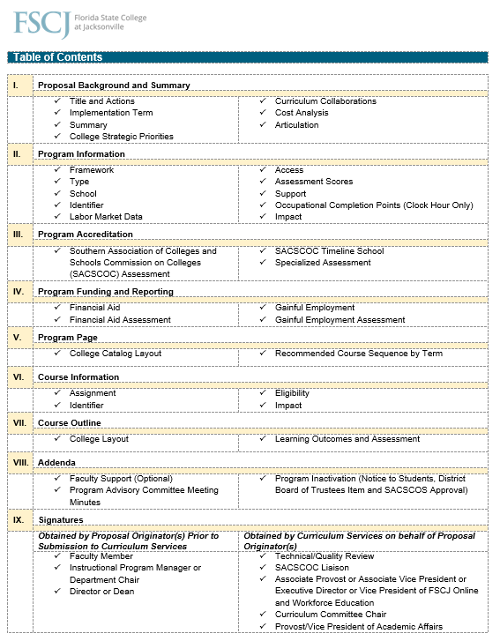
Curriculum Proposal Form
A dedicated member of the Curriculum Services team will partner with you throughout the process to ensure all areas of the proposal form are complete and any concerns or questions are addressed in a timely and sufficient manner.
Table of Contents
Proposal Background and Summary
Program Information
Program Accreditation
Program Funding and Reporting
Program Page (College Catalog)
Course Information
Course Outline
Addenda: Business and Industry Leadership Team (BILT) and Faculty Support
Signatures

Slide 13
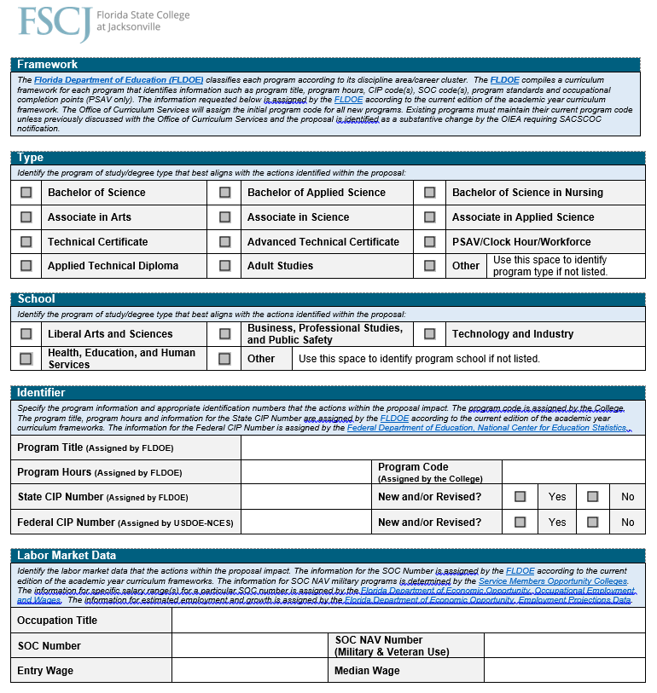
Program Information
Key Highlights
Basic program and “school of” information is required.
Most responses are based on the standards set forth by the FLDOE.
Many sections are prefilled by Curriculum Services on behalf of proposal originator.
New or significantly modified program must include Business and Industry Leadership Team (BILT) minutes.

Slide 14
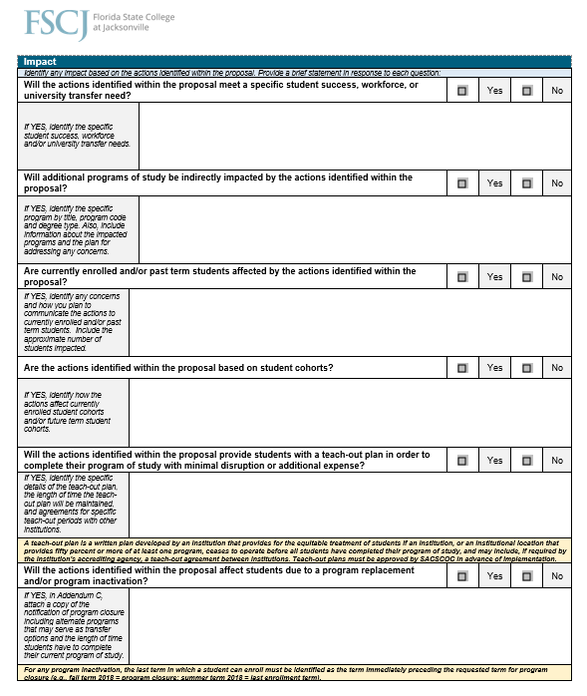
Student Impact
One of the most critical components of successful proposal development is a thoughtful analysis of the student impact.
Key Highlights
When a program and/or course is modified, currently enrolled and/or past term students may be affected.
Goal is to minimize disruption to students to avoid an overage or underage of credit or clock hours.
Curriculum Services can assist with planning a teach-out period or staggering implementation terms.

Slide 15
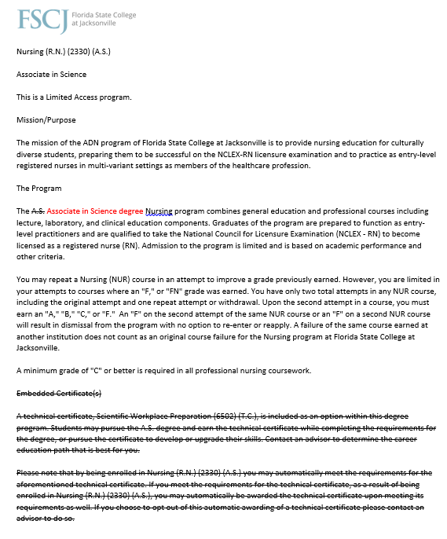

College Catalog Program Page
Alert: do not use TRACK CHANGES. Proposal submissions are not accepted in this format
Editing Conventions
Strikethrough feature to omit
Red font to add
For additions, please avoid using the yellow highlight feature as it is difficult to read when printing in black and white.

Slide 16
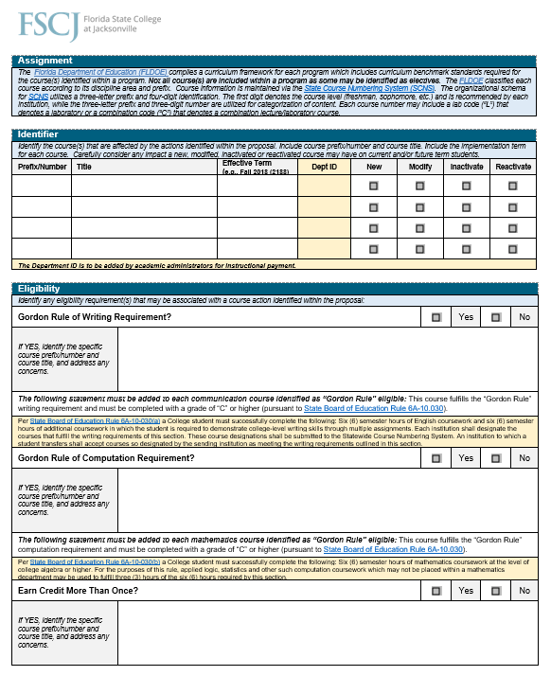
Course Information
Key Highlights
Basic course information is required including prefix, number, title, and effective term.
All courses listed should include a corresponding course outline with changes clearly documented.
Course outlines are prefilled by Curriculum Services on behalf of proposal originator.

Slide 17

Course Outline
Each course offered by the College includes an official course outline. The office of Curriculum Services serves as the official record keeper for all course outlines.
Course Number
Course Title
Prerequisite(s)
Corequisite(s)
Condition(s)
Credit Hours
Contact Hours/Week
Contact Hour Breakdown
Faculty Workload Points
Standardized Class Size Allocation
Suggested Texts
Topics per Contact Hour

Slide 18
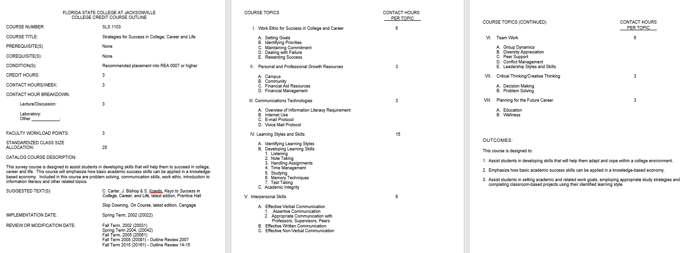
Course Outline

Slide 19


Course Learning Outcomes and Assessment
Most courses offered by the College include a course learning outcomes and assessment (CLOA) form attached to the official course outline.
Type of Course
General Education Discipline Area
Learning Outcomes
Type of Outcomes
Method of Assessment
Important Note:
The office of Curriculum Services regularly partners with the office of Institutional Effectiveness and Advancement to ensure curricular compliance with current discipline, program and/or course related outcomes and assessment methods.

Slide 20

Technical & Quality Review
As part of a commitment to curriculum accuracy, the office of Curriculum Services will conduct a thorough technical and quality review of all proposal submissions that have the appropriate dean’s signatory support.
General
Typos, grammar and format
Completeness (all questions answered)
Program and Course
Compliance with FLDOE curriculum standards
Program of study codes, CIP/Federal codes, SOC codes and employment data
Course prefix, number, description and credit/contact hours
Alignment of courses with the Statewide Course Numbering System
Admission requirements, prerequisites, corequisites and course sequencing
Workload assignment per current CBA and standard class size allocation
College Catalog program page accuracy
Articulation implications
Critical
Impact on students (past, present, future)
Verification with OIE for SACSCOC
District Board of Trustees approval
Confirmation of Financial Aid changes

Slide 21
Curriculum Committee & Follow-up Approvals

Slide 22

Curriculum Committee
Following the technical review and proposal finalization, the office of Curriculum Services requests signatory support from the appropriate Associate Provost.
Serves as a recommending body for curriculum action items to the Provost/Vice President of Academic Affairs
Comprised of 17 faculty members, 1 Student Government member, 7 academic administrators, 2 student services administrators and Ex-Officio members from the Center for E-Learning, the office of Financial Aid and Student Records
Meets the third Thursday of the month, September through April, with May and June reserved for ad-hoc meetings in response to state mandated or specialized accreditor needs
Agenda items are communicated five (5) business days prior to the meeting date
Originators present their proposed curriculum actions (3-5 minutes)
Chair (Faculty Senate President) provides signatory recommendation (if motion is passes)

Slide 23
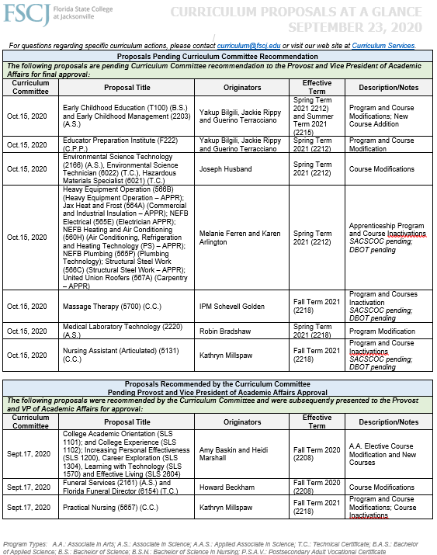
Approved Curriculum
Following the Curriculum Committee, the office of Curriculum Services provides to the Provost/Vice President of Academic Affairs a summary of all recommended actions items and requests signatory approval.
Status Update
The office of Curriculum Services maintains a document titled “Proposals at a Glance,” which can be accessed through the Curriculum Services SharePoint site.
This document provides a summary of all proposals currently in process and is updated regularly.
Following the close of the academic session, the document is compiled into an annual summary report for a variety of key stakeholders.

Slide 24
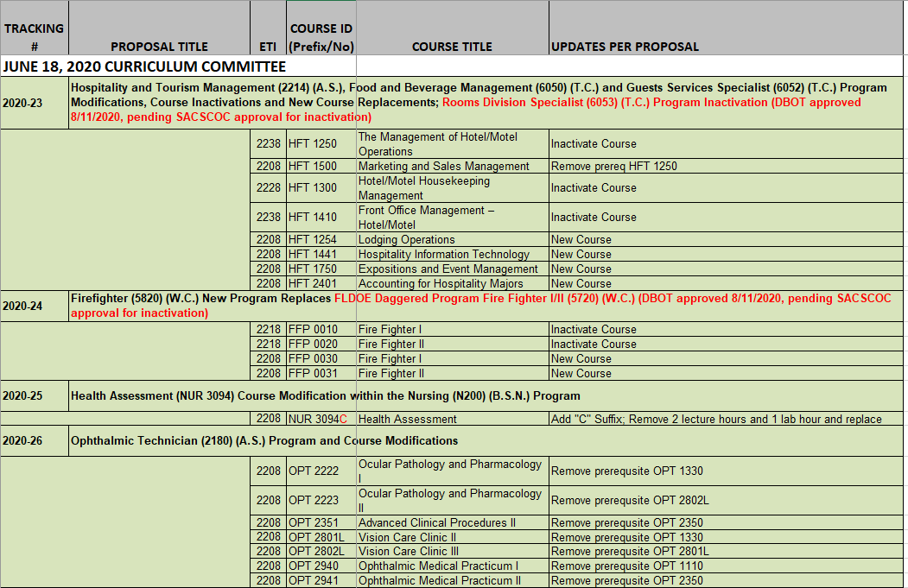
Status Sheet for Encoders
Informs Encoders of the Status of Curriculum that is In-Process
Color Coded to Advise When Curriculum is Ready to Encode and What is Pending Action
Updated Weekly to Align with Curriculum Committee Recommendations and Provost Approvals
COLOR CODING GUIDE
Red: Pending Provost Approval; not ready for encoding
Yellow: Provost Approval Received; Pending Input in PS Course Catalog; not ready for encoding
Blue: Pending; such as waiting for SACSCOC or Financial Aid approvals; not ready for encoding
Green: Provost Approval Received; all Curriculum Input Complete; ready for encoding

Slide 25


Systems Input
Once a proposal has been approved, the office of Curriculum Services updates the College’s data systems and communicates final approval Collegewide.
PeopleSoft Course Catalog
Statewide Course Numbering System
Course Outlines
College Catalog
SharePoint Site
District Board of Trustees
OIE for SACSCOC
Financial Aid Funding
Academic Advising Report
Communication of Approvals
ANNOUNCEMENT
As of June 2022, the College has engaged in a 5-year contract with Coursedog to create an enhanced curriculum process that will minimize multiple system date entry points and directly align approved curricular content with the College Catalog

Slide 26
Florida Department of Education (FLDOE), State Course Numbering System (SCNS), Accreditation, Board Approval and Financial Aid

Slide 27


Tour of the FLDOE Website
http://www.fldoe.org/

Slide 28
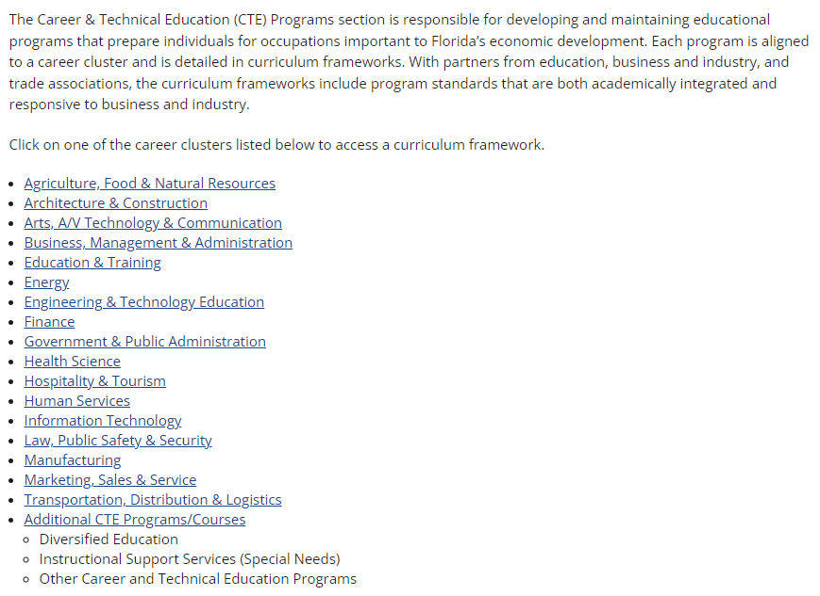

A Closer Look at the Curriculum Frameworks
https://www.fldoe.org/academics/career-adult-edu/career-tech-edu/curriculum-frameworks/

Slide 29
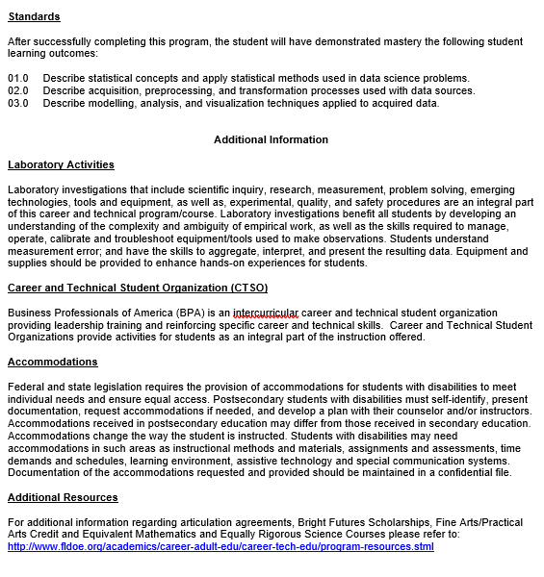
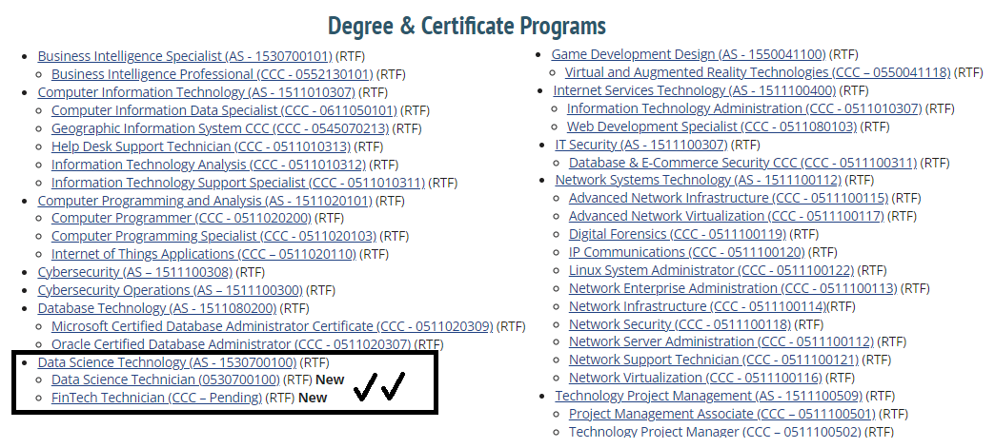
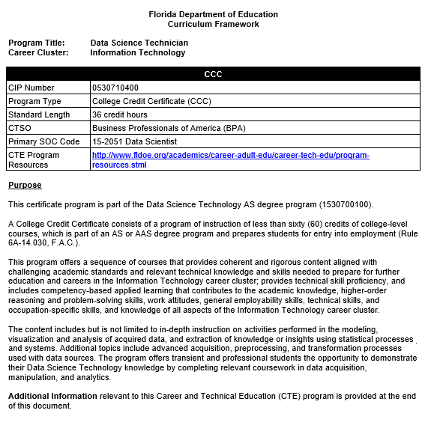
A Closer Look at the Curriculum Frameworks
https://www.fldoe.org/academics/career-adult-edu/career-tech-edu/curriculum-frameworks/
FLDOE CURRICULUM FRAMEWORKS

Slide 30
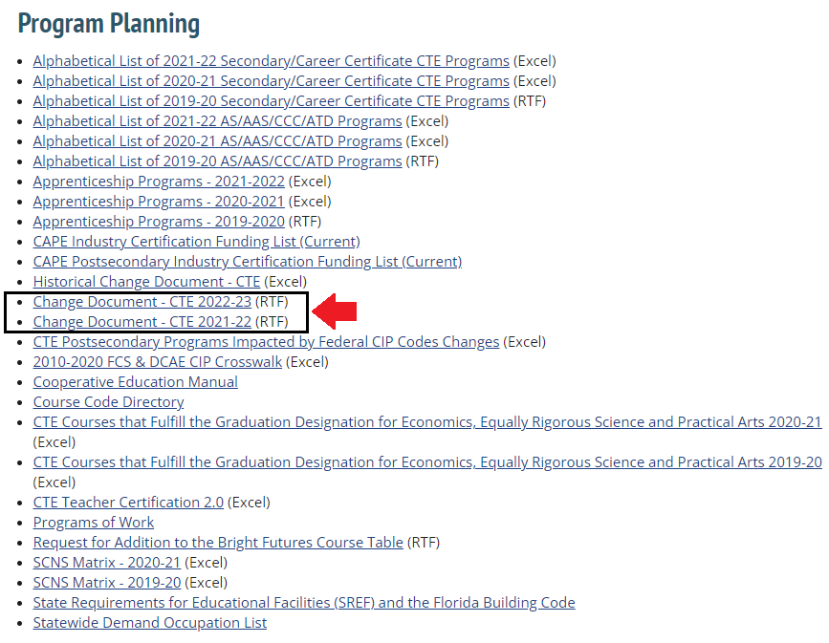
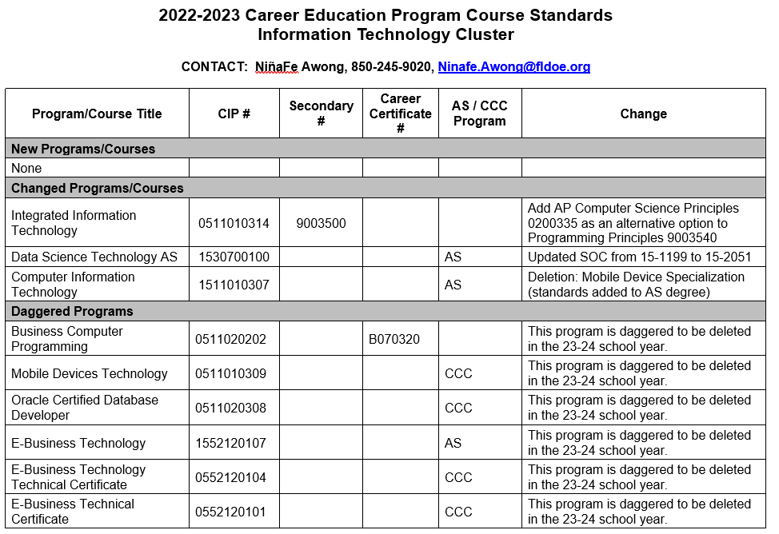
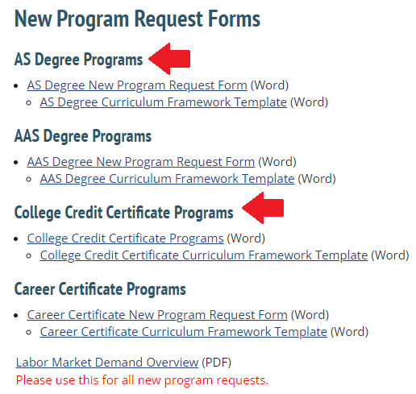
A Closer Look at the Curriculum Frameworks
https://www.fldoe.org/academics/career-adult-edu/career-tech-edu/curriculum-frameworks/
FLDOE CHANGE DOCUMENT

Slide 31

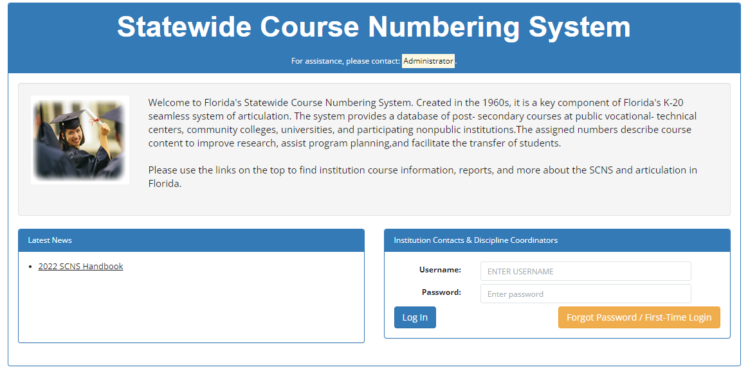
A Tour of the SCNS
https://flscns.fldoe.org/

Slide 32

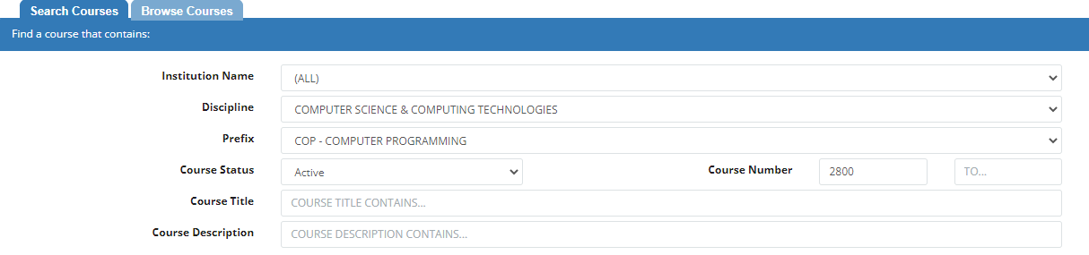
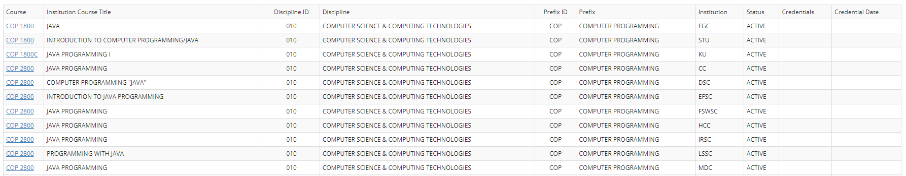
A Tour of the SCNS
https://flscns.fldoe.org/PbInstituteCourseSearch.aspx

Slide 33

Accreditation, Board Approval and Financial Aid
Depending upon the type of curriculum presented, additional approval may be required!
EXAMPLES OF ITEMS THAT REQUIRE FURTHER APPROVAL:
New Programs
Inactivated Programs
Substantially Modified Courses or Programs
Addition of New and/or Modification of Existing Off-Site Locations
The office of Curriculum Services will…
Draft items for presentation to the College’s District Board of Trustees
Partner with the office of Institutional Effectiveness and Advancement to ensure notification to the institutional and/or specialized accreditor(s)
Collaborate with the office of Financial Aid to ensure items that require ECAR submission are provided in a timely manner

Slide 34


Questions & Answers
Thank you so much for your participation.
If I can be of assistance to you with your curriculum process, please do not hesitate to contact me – I am happy to help.
Ms. Rebecca A. Nelson
Office: (904) 632-3274 | Cell: 904-207-2043
rebecca.nelson@fscj.edu

